Slide 1
Which basketball player’s stats are important to the team’s performance?

Slide 2
Introduction
In the game of basketball, the goal is to score more points than the opponent.
In the process, players collect multiple categories of stats such as rebounds, assists, steals, blocks, and turnovers.
In this analysis, we used historical boxscore for every game in the past 20 NBA seasons
We divided stats into 3 categories: passing, rebounding, and defense
Based on the historical data, which player’s stats contribute to the team’s performance?

Slide 3
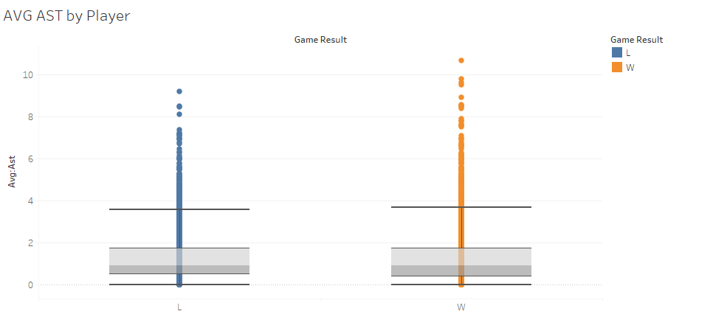
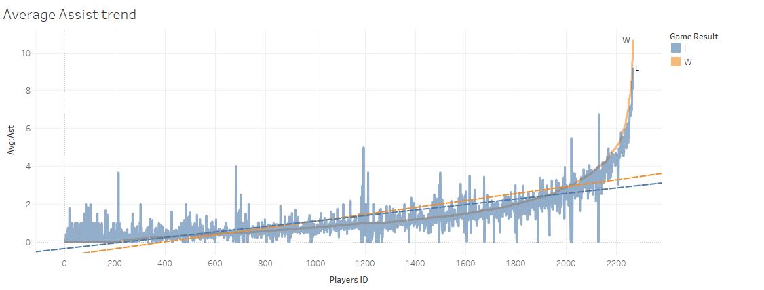
Passing: Assist
Assists are occured when a player’s pass is lead to basket scored
In past 20 years, players averaged 2.28 assists in Wins and 1.96 assists in Losses
In Wins, players collect 16.33% more assists.

Slide 4
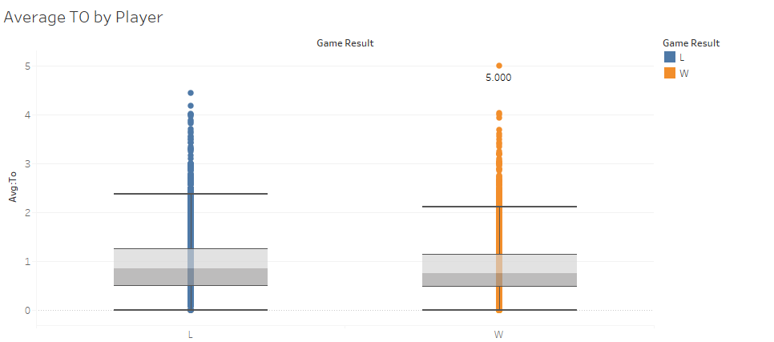
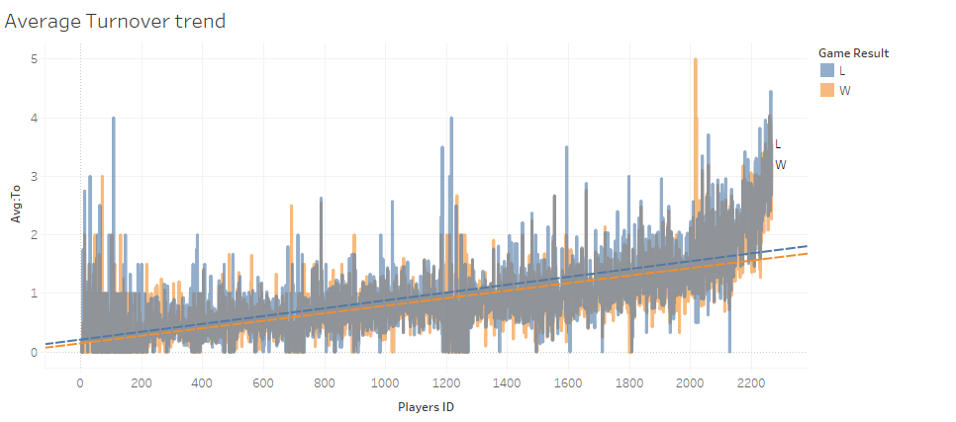
Passing: Turnover
Turnovers are occurred when player gives possession away to the other team.
In past 20 years, players averaged 1.28 assists in Wins and 1.37 turnovers in Losses
In Wins players collect 6.56% less turnovers

Slide 5
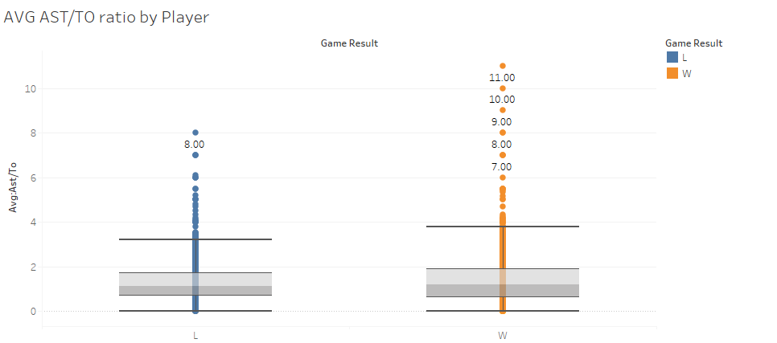
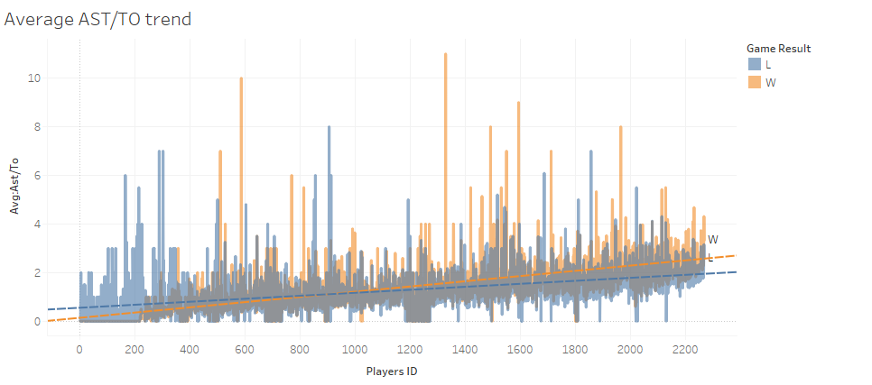
Passing: AST/TO Ratio
In past 20 years, players averaged 1.52 AST/TO in Wins and 1.27 AST/TO in Losses
In Wins, players show 19.69% higher AST/TO ratio
Most important passing stat that affects team’s performance

Slide 6

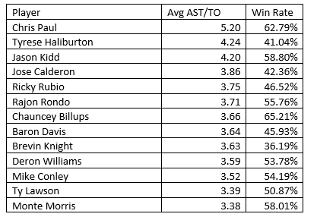
AST/TO Ratio: Top Players
In the sample of top players’ 10,326 games, they won 53.61% of the game.
More players have winning record (8) than losing record (5)

Slide 7
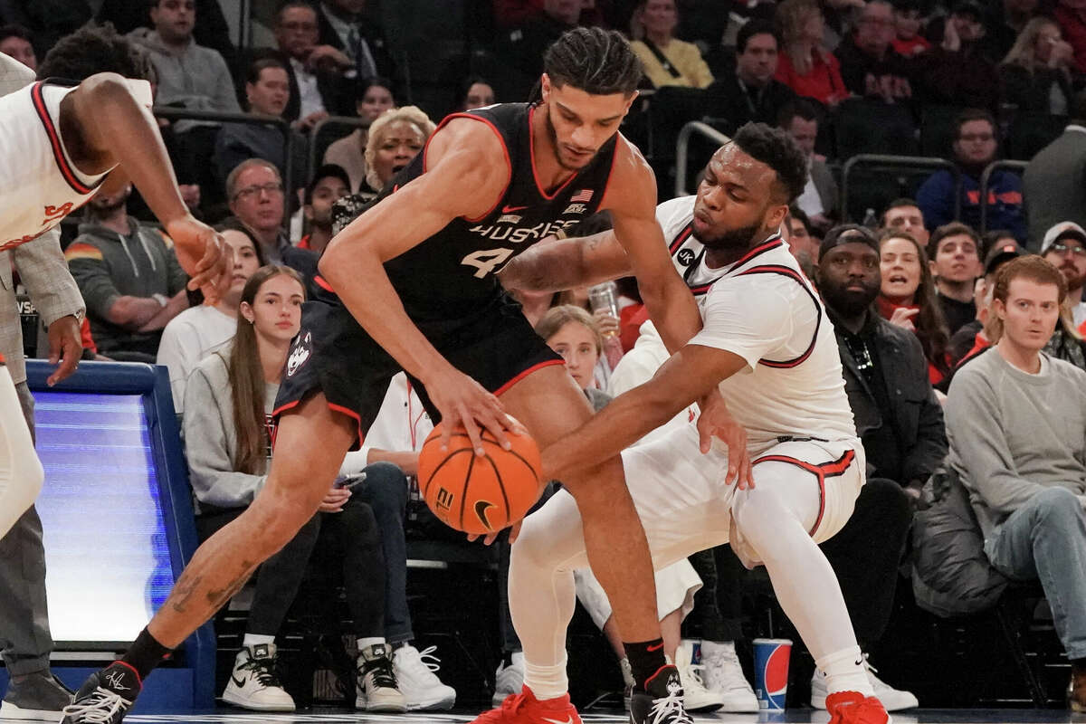
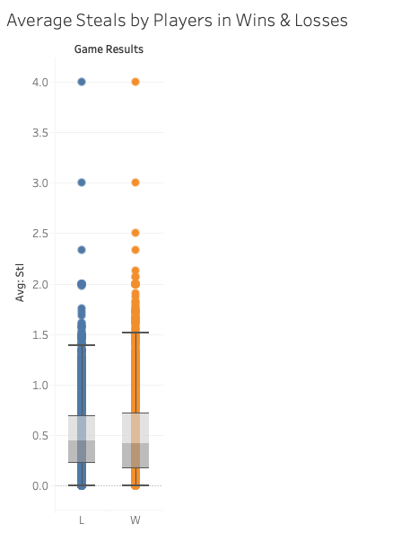
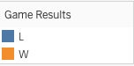
Defense: Steal
Steals occur when a defensive player gains possession of the ball by legally taking away the ball from offensive player.
In Wins, players averaged 0.76 steals, and in losses players’ averaged 0.68 steals. Players average 11.76% higher in Wins
Thus, proving positive correlation between steals and winning, the teams tend to perform better when they steal more on average.

Slide 8
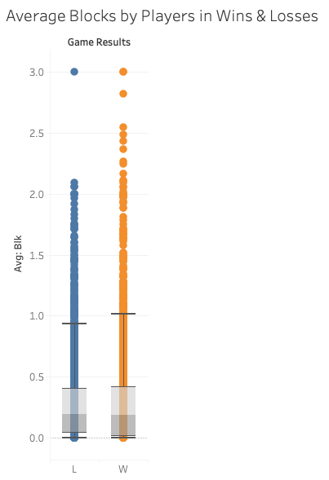

Defense: Block
Blocks or Blocked shots occur when defensive player successfully prevents the ball from going through the hoops, deflects or stops attempted goal by offensive player.
In Wins, players averaged 0.50 blocks, and in losses players’ averaged 0.42 blocks. Players average 19.04% higher in Wins
Thus, proving positive correlation between blocks and winning, the teams tend to perform better when they block more on average.

Slide 9
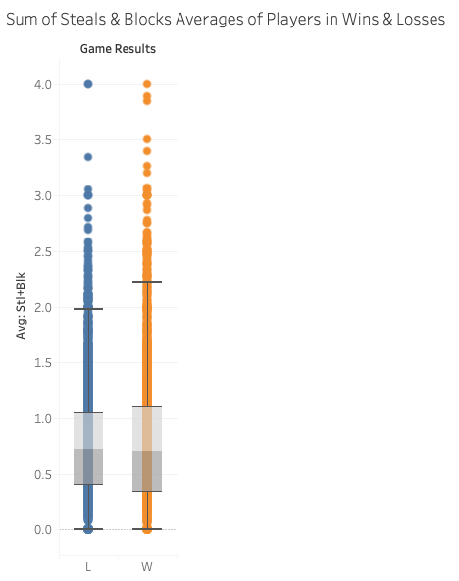

Defense: Steal+Block
Both Blocks and Steals are key defensive strategies as they demonstrate player’s ability to disrupt opponent’s offense and create scoring opportunities for their own team.
In Wins, players averaged 1.26 steals + blocks, and in losses players’ averaged 1.11 steals + blocks. Players average 13.51% higher in Wins.

Slide 10

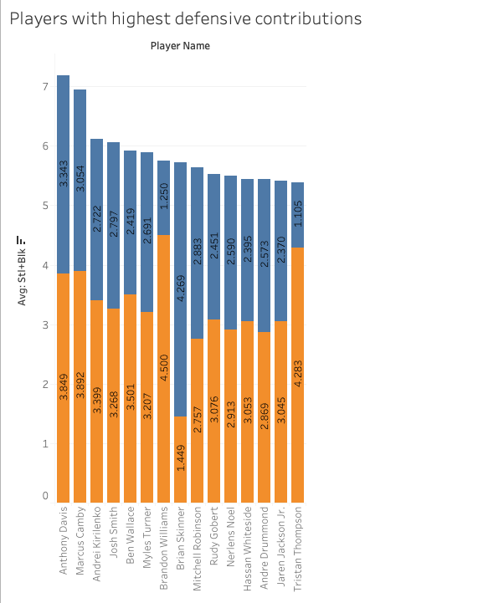
Top 15 Players with highest defensive contributions
These players have the highest average impact on the team’s performance as they are likely to ensure team’s success specifically in terms of the team’s defensive strategy.
Anthony Davis has the maximum steals and blocks combined average of 7.192.

Slide 11
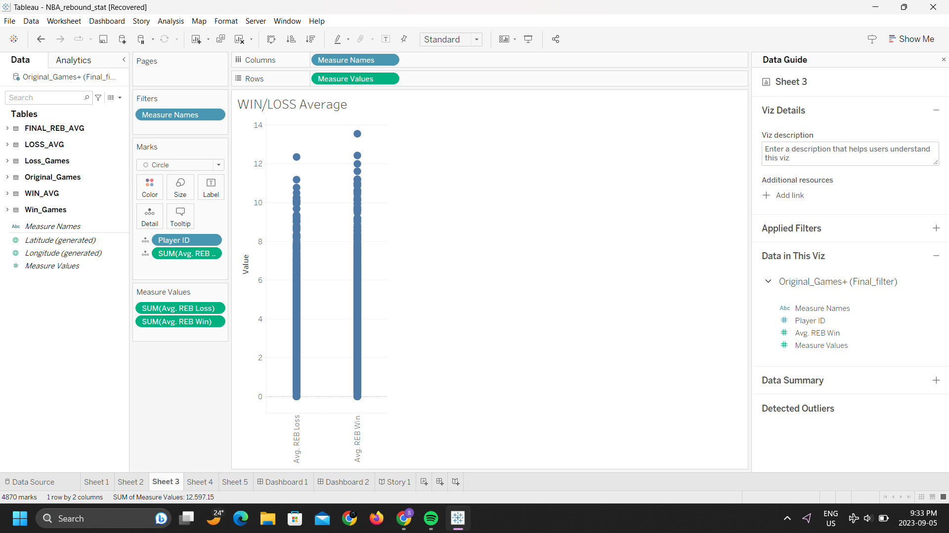
Rebounding: Total Rebound
A rebound occurs when a shot does not go in the net, instead bouncing off the rim or backboard into the hands of a player below.
Rebound does help to change the pace of the game by increasing the chances for the team catching the ball.
Average rebound came around 4.22 in all the winning games and 3.9 average in their lost games, 8.22% higher.

Slide 12

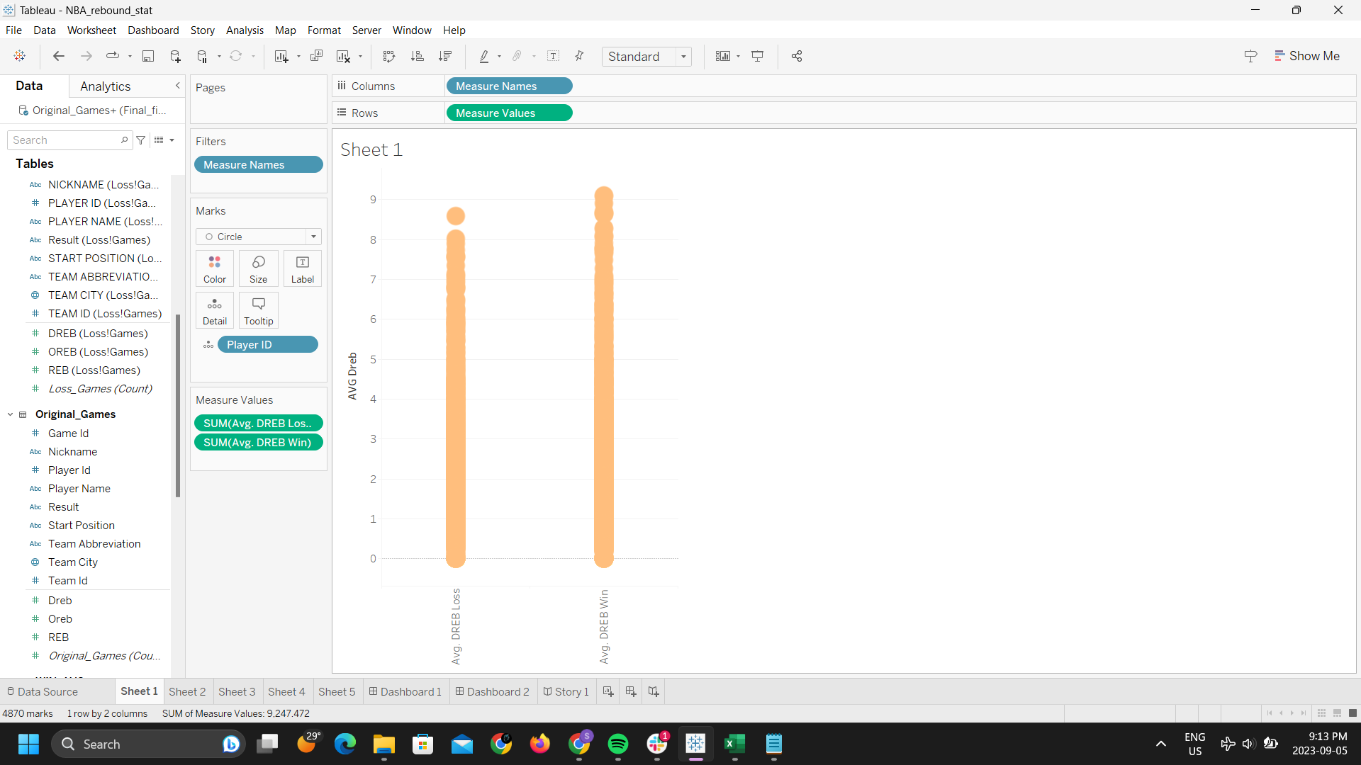
Rebounding: Defensive Rebound
Defensive rebound occurs when defensive player takes possession of the ball after an offensive player’s missed shot attempt.
In Wins, players averaged 3.21 defensive rebounds
In Losses, players averaged 2.86 defensive rebounds
Players averaged 12.29% more defensive rebounds in Wins

Slide 13
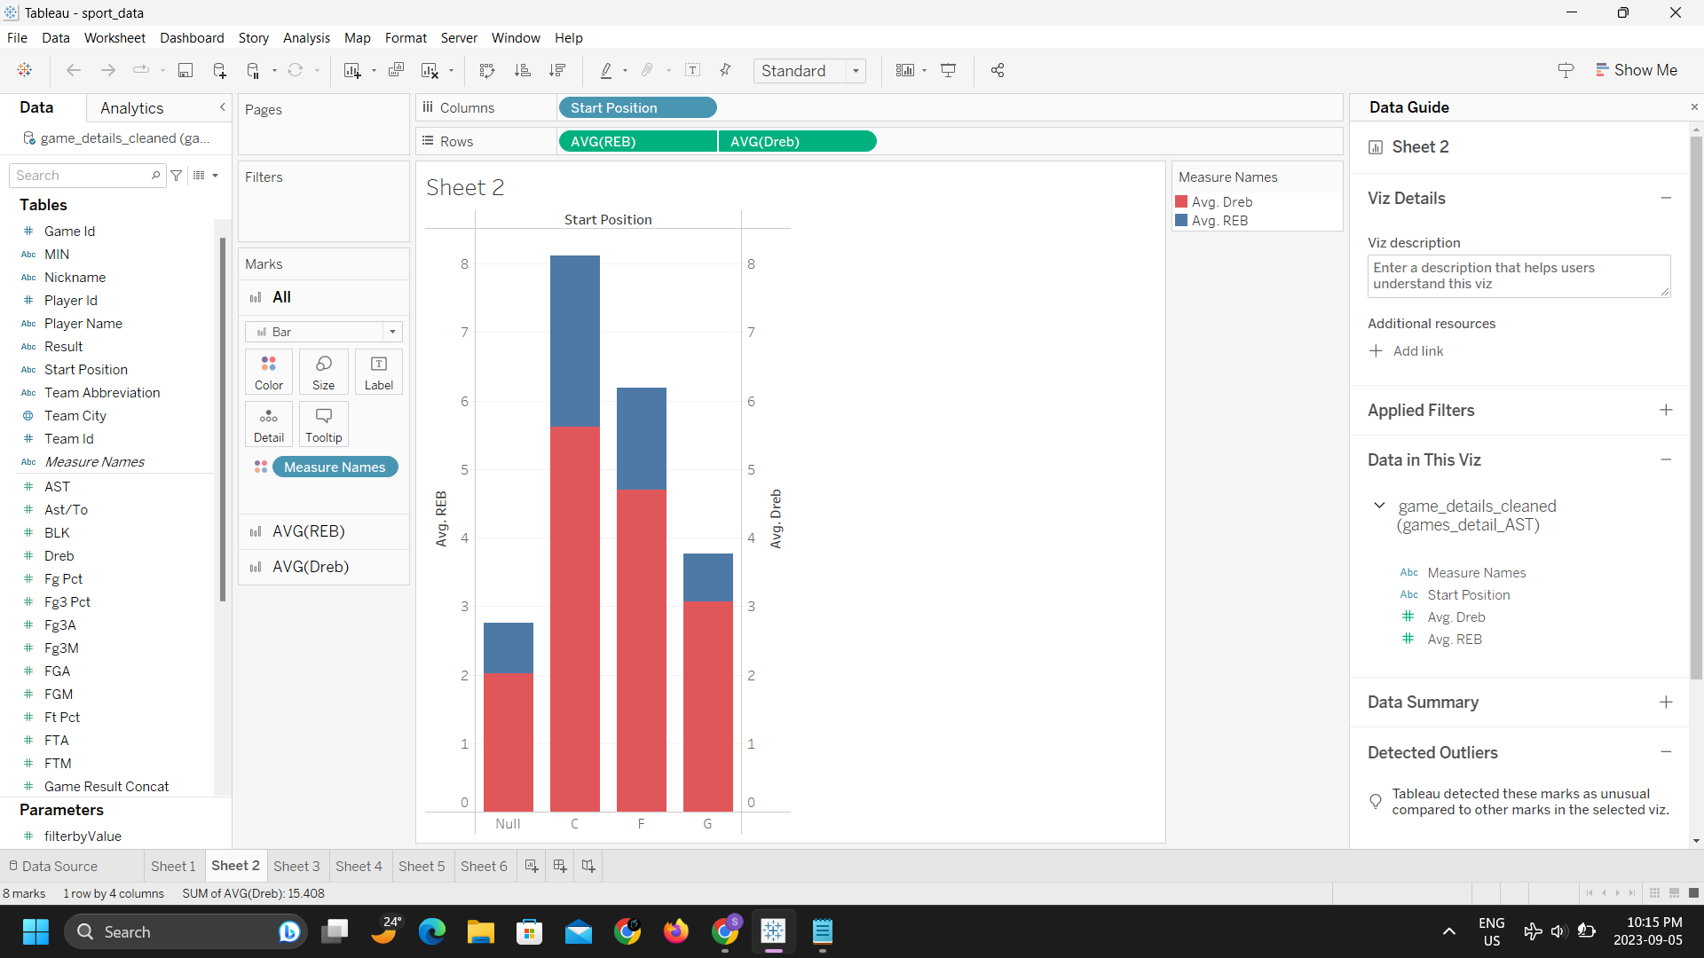
Defensive rebound from different position
Here C - Center, F - Forward , G - Guard and Null values are usually for players when they get substitute for partial game
Players who plays on center position are usually better in getting defensive rebounds , their average comes to around 5.6.
Red bars represents Average DREB from total average REB

Slide 14

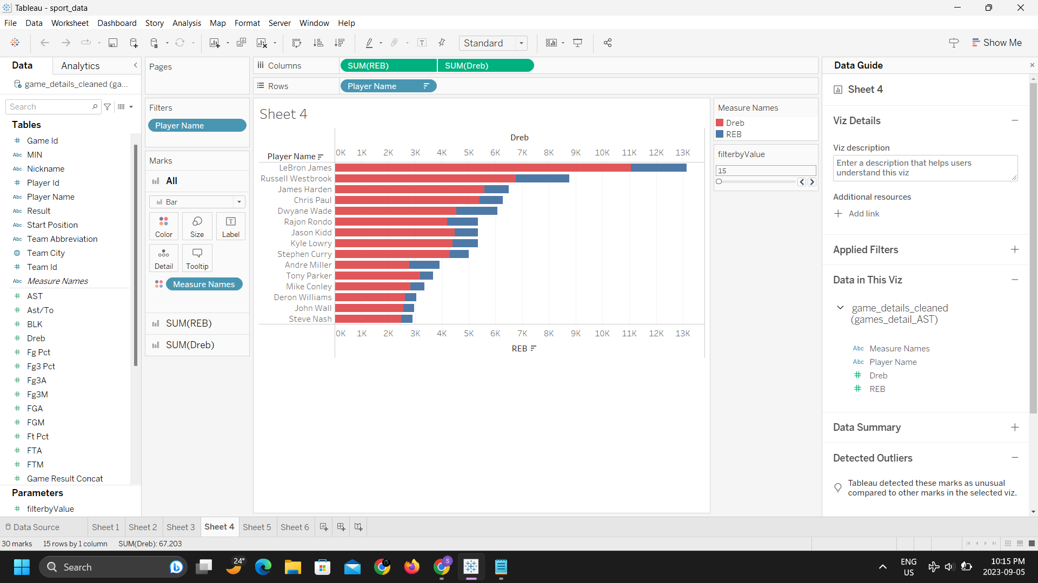
Let’s take a look at top 15 Players with most Defensive rebounds
Lebron seems to have approx. 15k more DREB then the 2nd best in the list

Slide 15
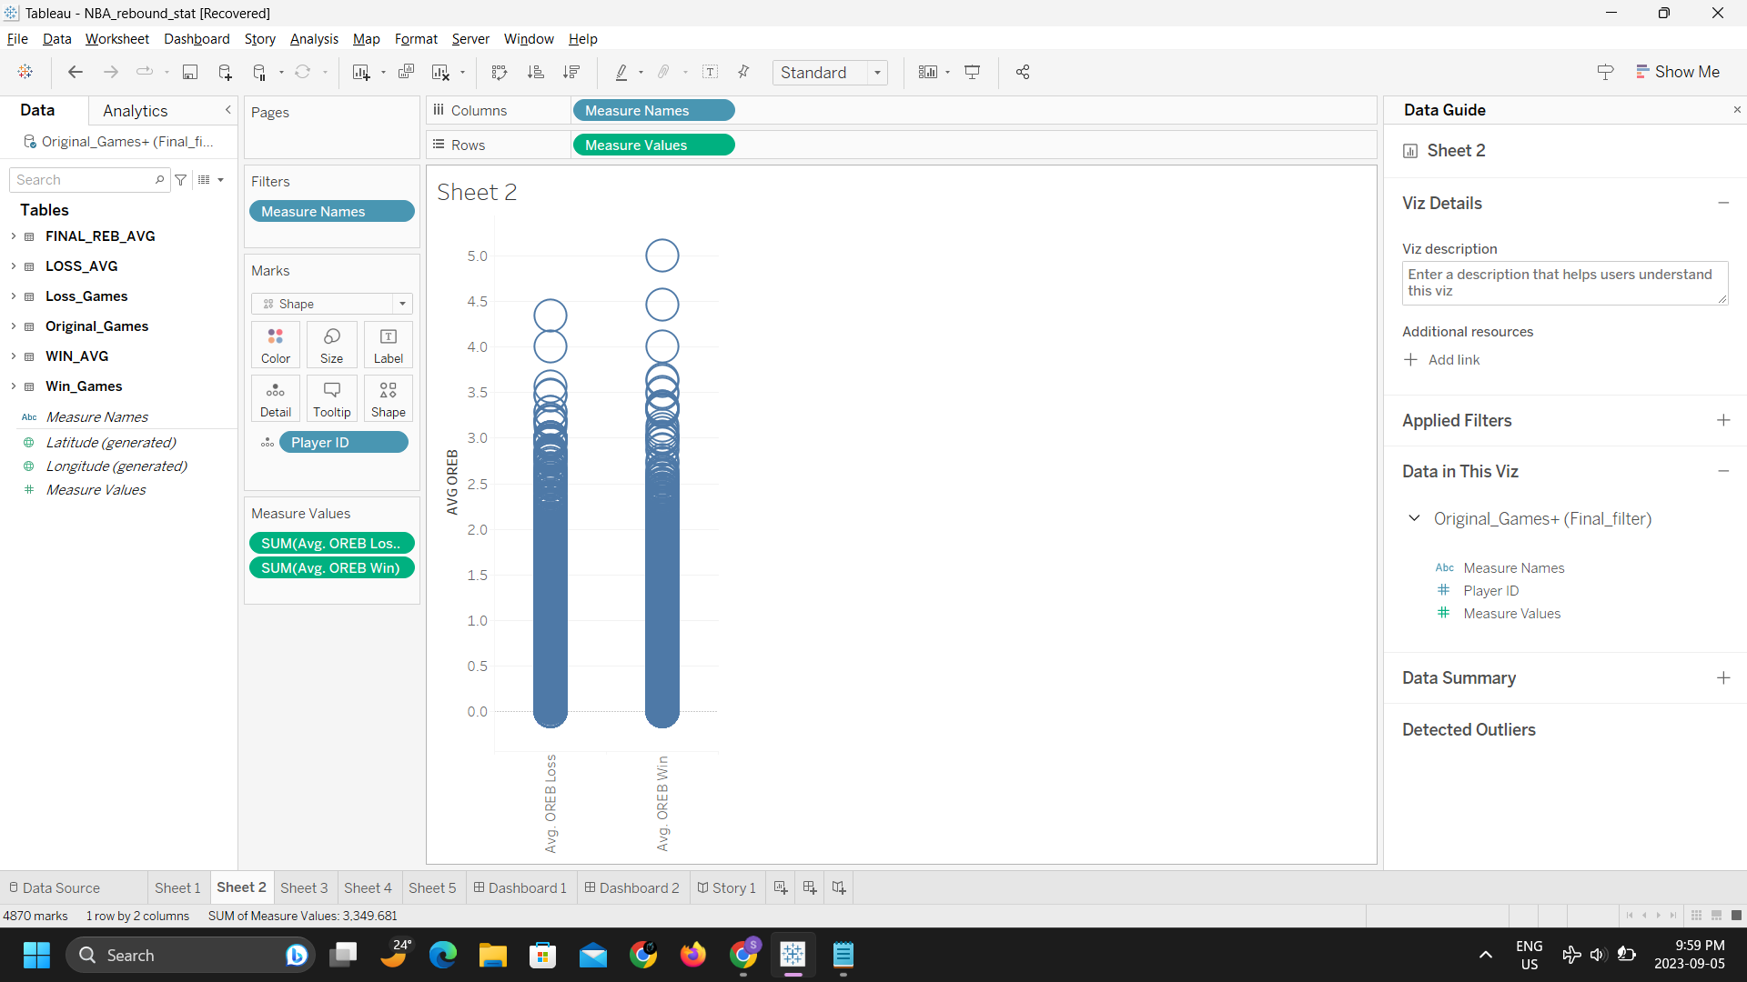
Rebounding: Offensive Rebound
An offensive rebound occurs in basketball when an offensive player takes possession of the ball after teammate’s missed shot attempt.
In Wins, players averaged 1.01 offensive rebounds
In Losses, players averaged 1.04 offensive rebounds
Players averaged 2.89% less offensive rebounds in Wins

Slide 16

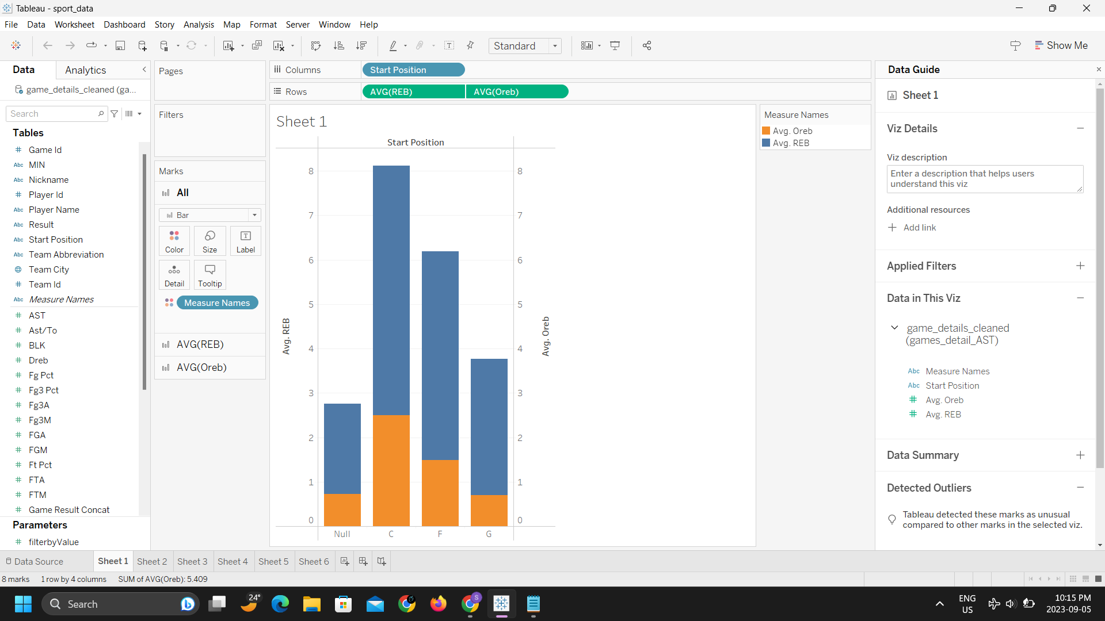
Offensive rebound from different position
So it seems players playing as center have more chances to get rebounds
Here we can see yellow bar representing Average Offensive rebound out of total average Rebound
Avg OREB for Center positioned player is 2.5

Slide 17

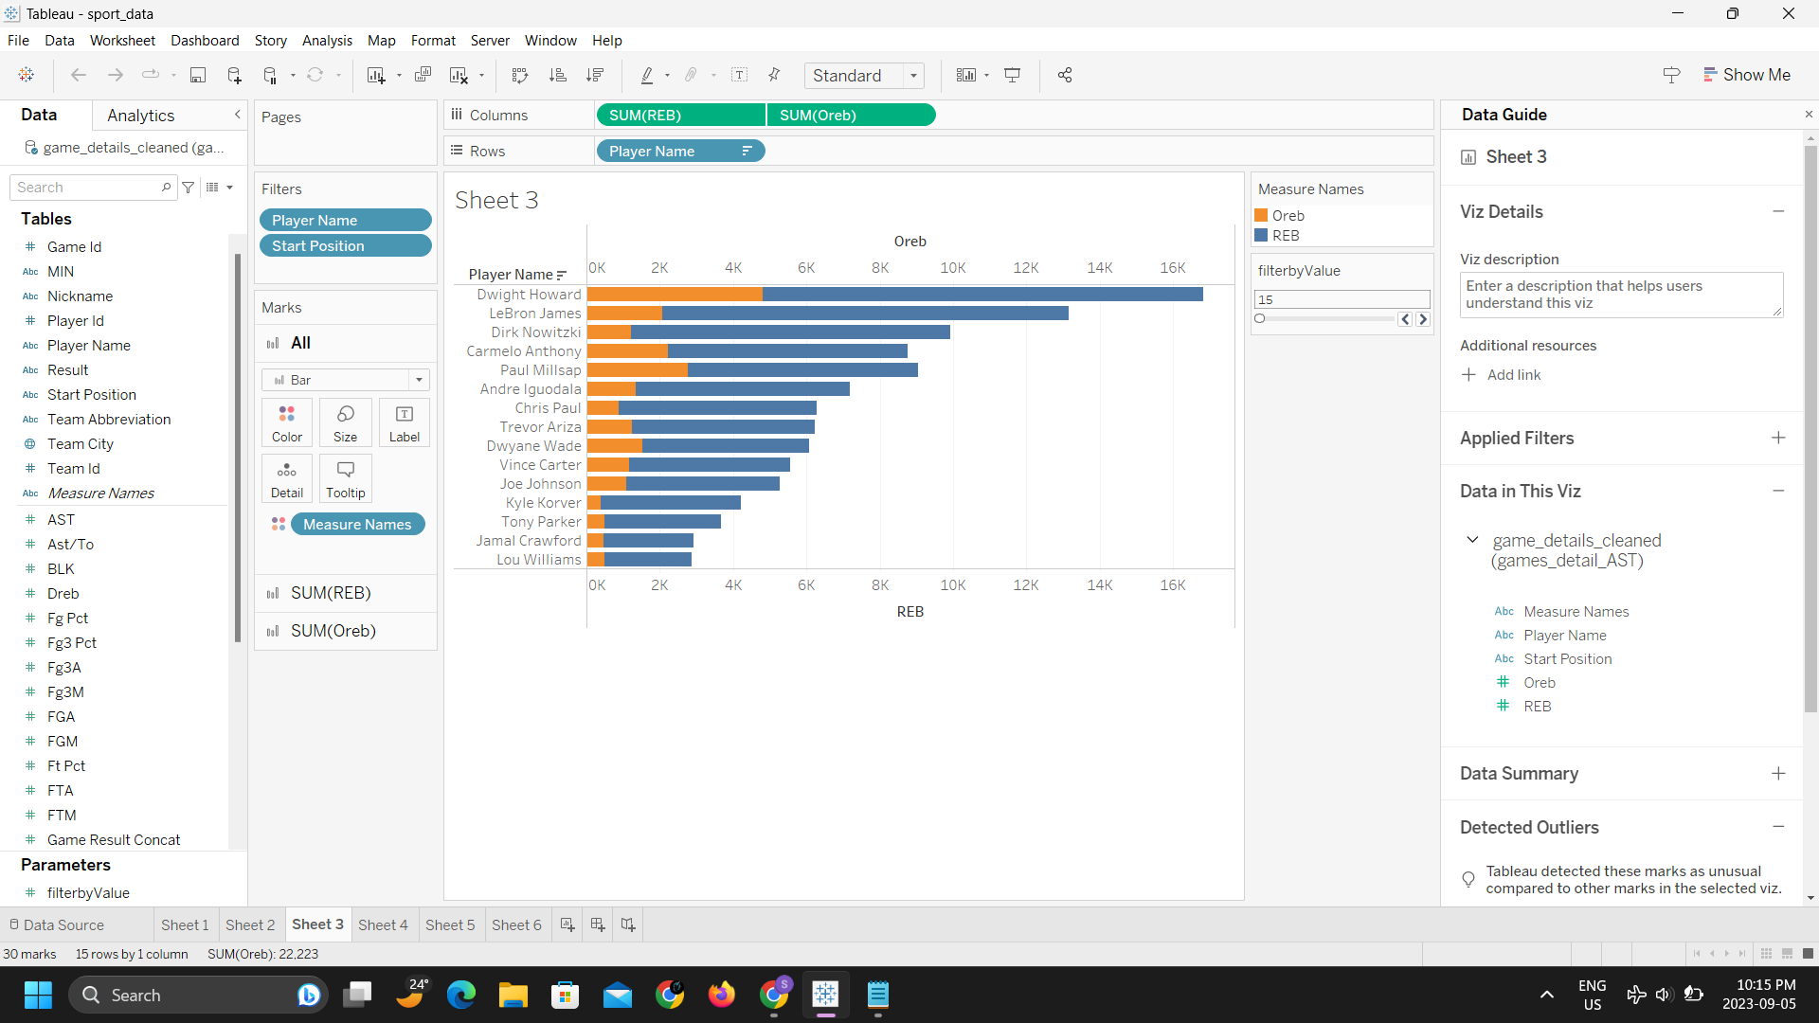
Let’s take a look at top 15 Players with most Offensive rebounds
When it comes to OREB Dwight Howard is topping the charts by almost 2.5k more than the 2nd highest i.e. Paul Millsap

Slide 18
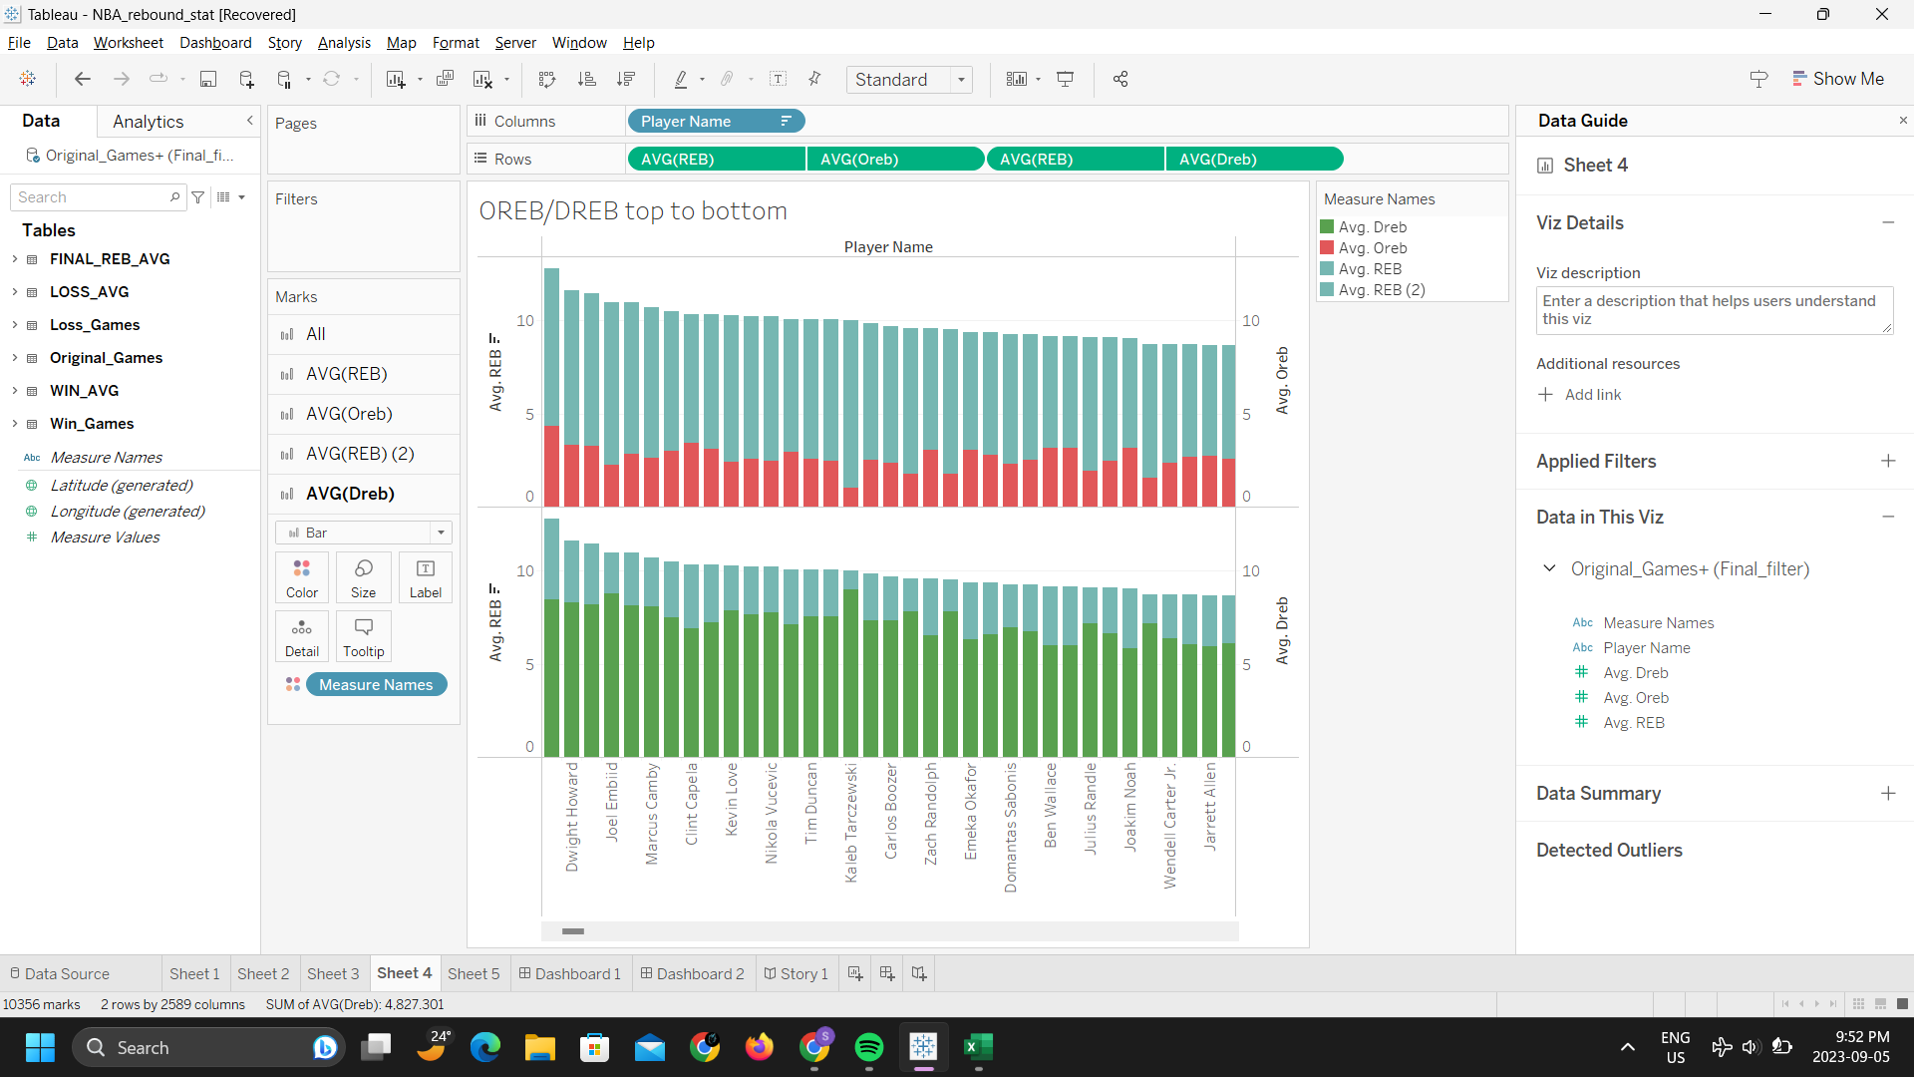
Looking at the data differently
Looking at some general outcome for every player, it seems easy to get rebounds from the defensive end as compare to offensive one.

Slide 19
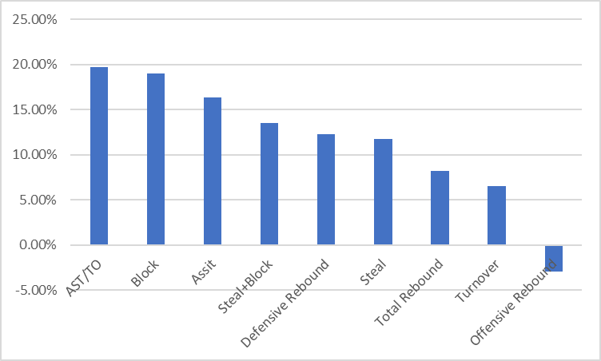
Conclusion
While all stat categories have impact on team’s performance, some stats have more importance than the other.
AST/TO (19.69%) and Block (19.04%) have the biggest differences between Wins and Losses
Some stats such as Offensive Rebound does not have positive correlation with team’s performance.

